Slide 1
Executive Media

Slide 2

Personas

Slide 3
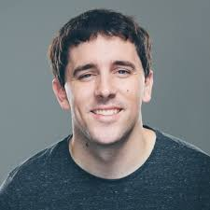
Brayan Tyler
Student
21, Male
Pursuing MBA
Motivation
Bryan had a bad experience sharing one of his idea with college professors and just got demotivation in return. He is trying to reach out different companies heads by many way to share his idea but no one is properly responding. And if he is lucky enough for a meet, he is not properly able to showcase his ideas and take the proper feedback from that.
Goal
Need a active platform were he can share his Ideas and get professional feedback.
Need a mentor.
Frustration
Not been able to share his business idea which right people.
Getting demotivated and he is afraid that he might have to work under someone forcefully.

Slide 4
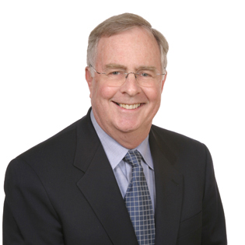
Steve Johnson
CXO @ Tech Corp, Michigan.
47, Male
MIT Graduate
1,50,000/Annum
Motivation
Goal
Can invest in start up ideas if they looks promising.
Frustration

Slide 5
NGO Manager

Slide 6

Information Architecture

Slide 8
Website Wireframes

Slide 9
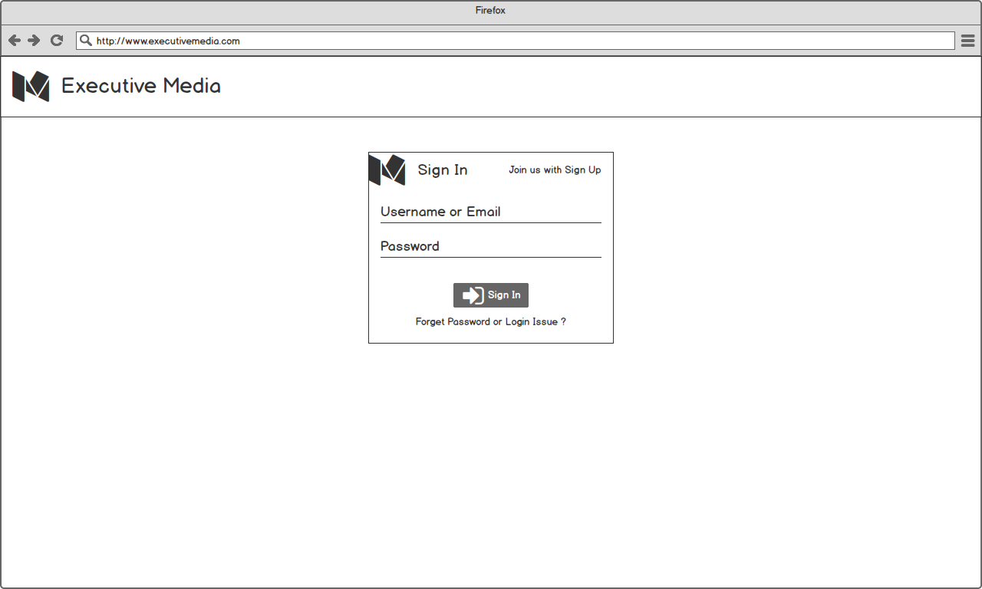
Login Screen

Slide 10
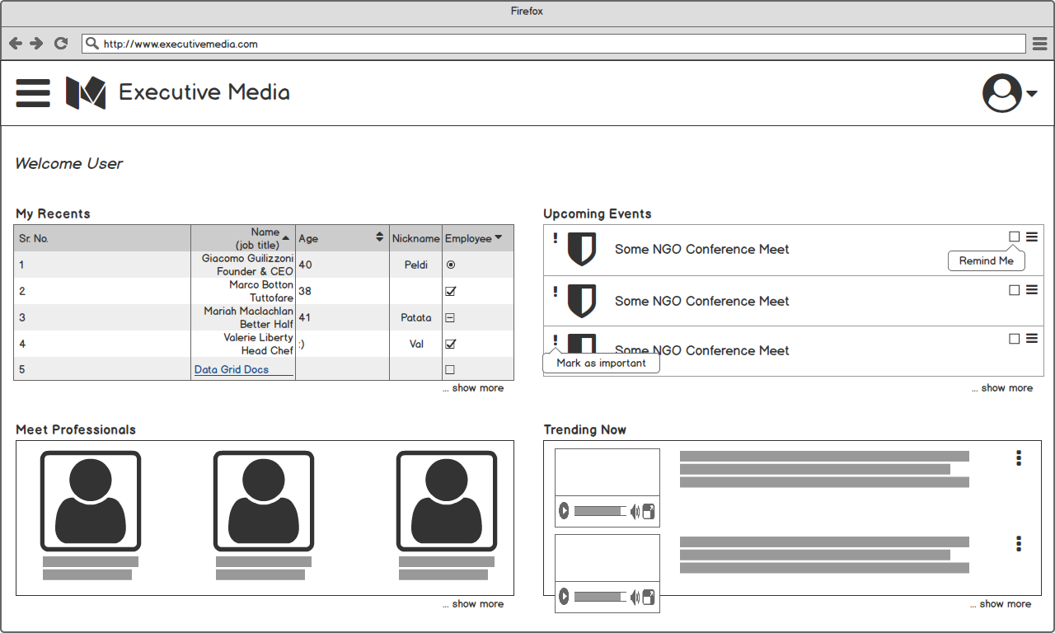
User Home Page

Slide 11
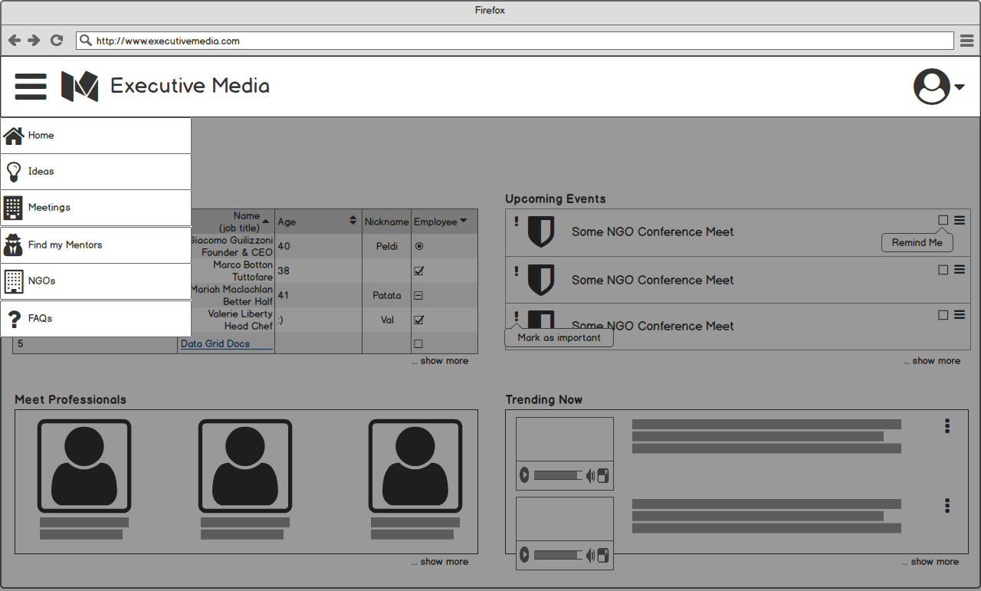
User Hamburger Menu

Slide 12
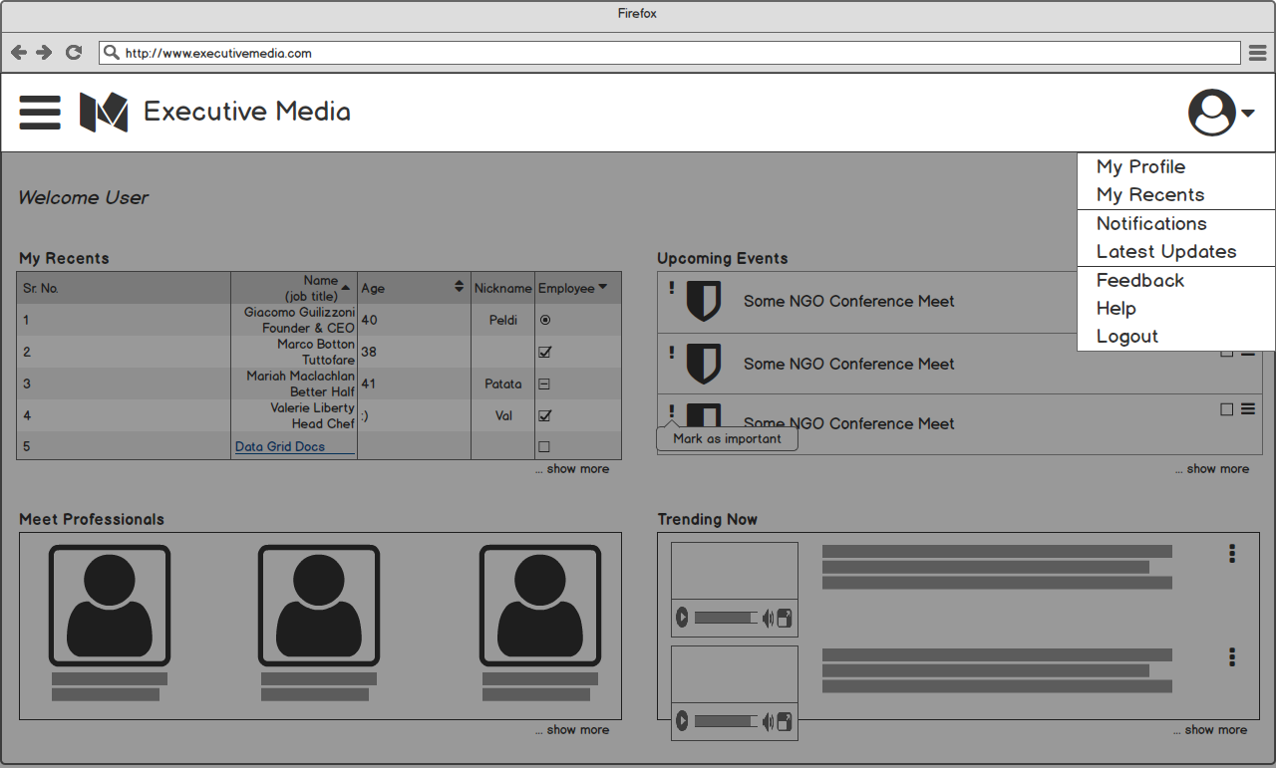
User Profile Menu

Slide 13
User Idea Page

